Slide 1
Customer Churn Prediction Helping SyriaTel Keep More Customers
Name: Chris Mau Karagu
Phase 3 Project

Slide 2
Overview
SyriaTel is losing customers every month.
Losing customers means losing revenue.
It is much cheaper to keep current customers than to find new ones.
The goal is to create a simple tool that predicts which customers are likely to leave soon.

Slide 3
Business Problem
Customer churn is a big challenge for SyriaTel.
We want to identify at-risk customers before they leave.
Early action can help us retain them.
Success = Reducing customer loss and protecting company income.

Slide 4
Data Understanding
I analyzed data from 3,333 customers.
Information included: call minutes, charges, international plan, voicemail plan, customer service calls, etc.
The data showed clear patterns between customer behavior and churn.
Key fact: Only 14.5% of customers churned (483 left, 2,850 stayed).
This is well observed on the next slide.

Slide 5
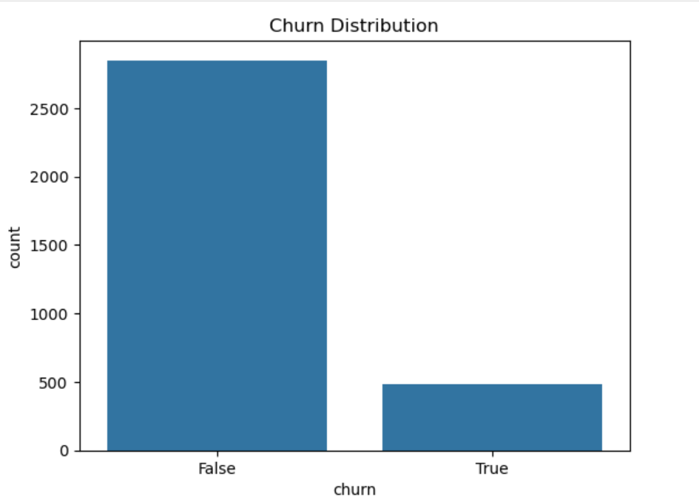
Data Understanding

Slide 6
Modelling
I built a prediction tool that answers the question: “Is this customer likely to leave or stay?”
I used classification as it sorts customers into two groups: Likely to stay and Likely to churn.
This is useful because instead of waiting for customers to cancel, we can know in advance and take action to keep them.
I tested different approaches and chose the best one for our business needs.

Slide 7
Evaluation
I started with Logistic Regression. It was simple but missed many churners.
I then tried a balanced version of it. It found more churners but gave too many false alarms.
Finally, I used a Decision Tree. It performed best overall.

Slide 8
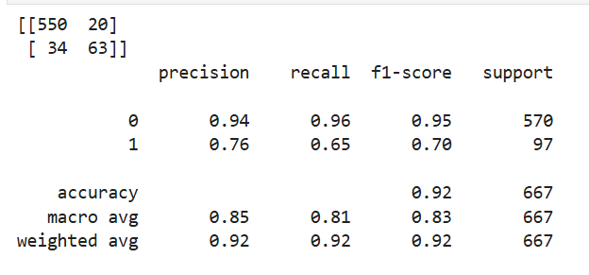
Model Results

Slide 9
Model Results
Decision Tree Results:
Correctly finds 65% of customers who leave.
When it flags someone, it is right 76% of the time.
Overall accuracy: 92%
This is good for business. We can catch many at-risk customers without wasting effort on too many wrong predictions.

Slide 10
What We Learned
The model taught us important things:
Many customer service calls resulted in higher chance of leaving.
International plan users churn more.
Voice mail users usually stay longer.
These patterns help us know where to focus.

Slide 11
Recommendations
To reduce churn, SyriaTel should:
Improve customer service.
Check international plan pricing.
Promote voicemail services.
Use the tool every month to find at-risk customers and offer help.

Slide 12
Next Steps
Use the model every month.
Combine with special offers.
Measure how many customers we keep.

Slide 13
Thank You!

